Slide 1

Agentic AI: The Next Evolution
Explore the transformative potential of Agentic AI. These autonomous agents perceive, reason, and act. They shift from passive assistants to proactive problem solvers. Imagine AI managing schedules, finances, and health.

Slide 2
Key Components of Agentic AI
Perception
Reasoning
Action
Learning
Computer vision and NLP allow agents to understand data.
Planning and decision-making enable intelligent action.
Robotics and software automation execute tasks effectively.
Reinforcement and transfer learning enhance performance.

Slide 3

Capabilities of Agentic AI
Autonomous Task Completion
Adaptive Planning
Continuous Learning
Proactive Problem Solving
Handles multi-step tasks without needing human intervention.
Adjusts strategies based on real-time feedback and changing conditions.
Identifies and addresses issues before they escalate significantly.
Improves performance through experience and available data.

Slide 4
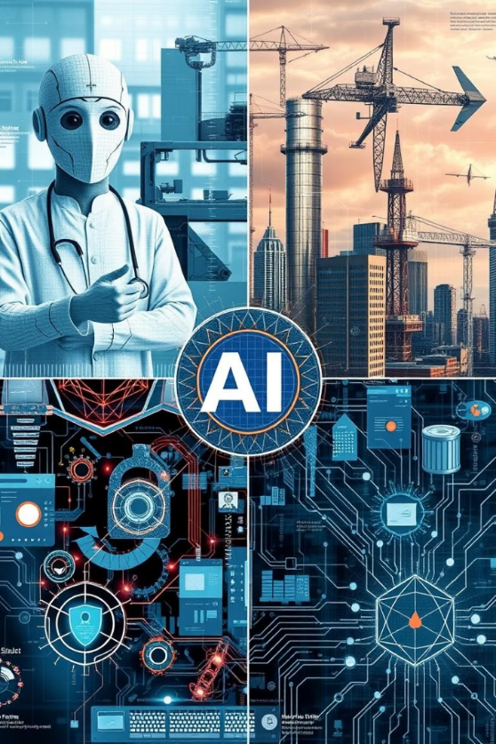




Real-World Applications
Healthcare
Finance
Manufacturing
Diagnosing diseases and personalizing treatments for patients.
Algorithmic trading and fraud detection for financial security.
Optimizing production lines and improving quality control with robots.
Cybersecurity
Detecting threats and responding to security incidents effectively.

Slide 5




Agentic AI in Software Development
Automated Coding
Automates code generation and debugging tasks.
Streamlined Project Management
Task assignment and progress tracking.
Improved Software Quality
Automated testing and bug detection.

Slide 6

The Agentic AI Development Lifecycle
Data Ingestion
1
Model Training
2
4
Monitoring
3
Agent Deployment
The lifecycle starts with data ingestion. Next is model training. Agents are deployed then integrated. This includes monitoring and improvement.

Slide 7

Challenges and Limitations
Ethical Concerns
Bias, fairness, and transparency issues.
Security Risks
Vulnerability to attacks and data breaches.
Technical Challenges
Scalability, robustness, and explainability.
Data Dependency
Reliance on high-quality, labeled data.

Slide 8

Overcoming the Challenges
Ethical Frameworks
Develop AI frameworks and guidelines.
Security Measures
Implement data privacy protocols.
Invest in Research
Improve AI explainability.
Foster Collaboration
Encourage stakeholders to collaborate.

Slide 9

The Future of Agentic AI
Increased Autonomy
1
Enhance intelligence.
Technology Integration
2
Integrate with blockchain and IoT.
Wider Adoption
3
Expand across industries.
Human-AI Collaboration
4
Focus on collaboration.

Slide 10

Embracing the Agentic AI Revolution
Agentic AI represents a significant paradigm shift. Careful planning and ethical considerations are vital. Offers tremendous potential for productivity. Explore and experiment with Agentic AI responsibly.

Slide 11

Thank you for your time and attention! I'm Sahir Ahmed Sheikh, Pursuing a career as an Agentic AI Developer and currently working as a Full Stack Developer. It's been a pleasure sharing these insights with you. I hope you found this presentation informative and valuable. Feel free to connect with me on [LinkedIn profile URL] or reach out via email at [email address]. Thank you for reading!

